Slide 1
A Study Of The Book Of Revelation
June 27, 2021

Slide 2
The Harlot Of Chapter 17
Revelation 17
The harlot (mother of harlots) – the object of coming judgment – the sentence is pronounced
In the OT three cities are designated as “Harlots” and another as a mistress given to pleasure.
Nineveh. Nahum 3:1, 4 (Cruelty)
Tyre. Isaiah 23:15-17; Ezekiel 26-27 (Commerce)
Babylon. Isaiah 47:5-15; Jeremiah 50-51 (Pleasure)
Israel and Judah. Jeremiah, Ezekiel, Hosea, and Micah. (Isaiah 1:21; 57:3-12 [mg]; Ezekiel 16:3-43; 23:1-49; Jeremiah 2:20, 25-28; 13:22), (Religion)
Angel brings the message
Awful harlot in contrast with the bride of Christ
Follows the pouring out the bowls God’s wrath
Rome was a compilation of all of the above.
Now will receive some of the “details” …

Slide 3
The Harlot’s Description
Revelation 17
“Sits on many waters” cf. Jeremiah 51:13
City that reigns over the kings of the earth. (verse 18)
“With whom the kings of the earth committed fornication”
Her alliances – all the nations who joined in her ungodly conduct
“Inhabitants of the earth made drunk with wine of her fornication”
Her evil corrupted nations and individuals to share in her wealth and sin! (cf. 13:11-18)

Slide 4
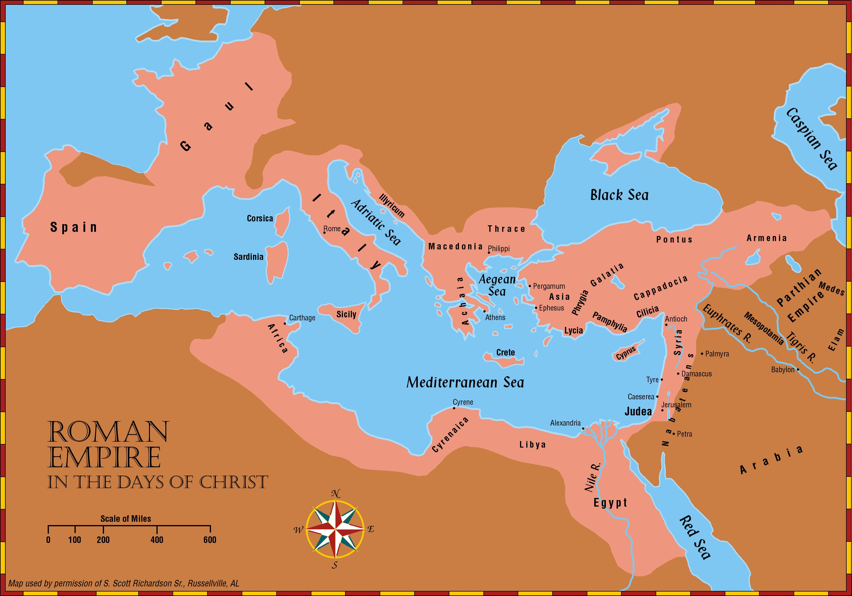

Slide 5
From Revelation 14:8 and 16:19
Judgment of Wicked Babylon
“Some expositors identify Jerusalem as the Babylon/harlot of the book of Revelation, and they see the fall of Jerusalem in A.D. 70 at the hands of the Romans as the battle of Armageddon.
Such an interpretation radically changes the thrust of the visions.
The beast (Roman Empire) and the false prophet (paganism) are the ones being punished by God. [Revelation 13-14 mg]
Other Scriptures did prophesy that God would use the Romans to destroy Jerusalem (Matt. 24; Luke 17, 21), but those are different contexts than Revelation.
The point is that what may be true of one context does not necessarily mean that every other context using the same words has the same application.”
(Robert Harkrider, Revelation, Truth Commentaries, page 322)

Slide 6
From Revelation 14:8 and 16:19
Judgment of Wicked Babylon
The ONE great conflict in Revelation is between Satan and his allies against Christ and His army.
That conflict was not between the Roman Empire and Judaism; instead, it was the Lord versus Satan with his allies, the beast (Rome) and false prophet (Paganism) of Revelation 13.
This conflict draws to a climax in Revelation 16:12-17 when the forces of evil are described as gathering for “the battle of that great day of God Almighty” (16:14) at Armageddon. cf. 19:19-21
While it is true, the prophet Isaiah referred to apostate Jerusalem as “the faithful city become an harlot! it was full of judgment; righteousness lodged in it; but now murderers.” (Isaiah 1:21 KJV; cf. Matthew 23:34ff)
Why would the vision be sidetracked from its major theme to present alleged details of conflict between Rome and Judaism?
Note: What Babylon does, the Beast does. cf. Revelation 14:8-10

Slide 7
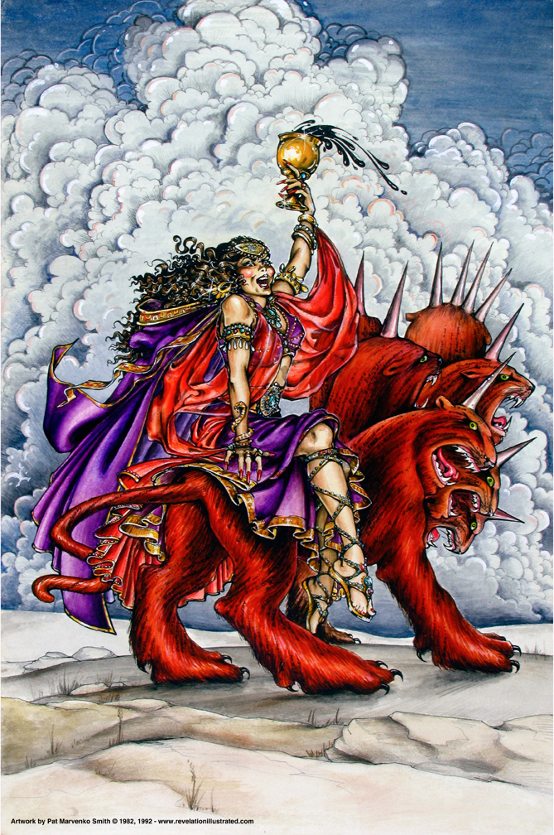
Book of Revelation: Chapter 18
Fallen is Babylon the Great

Slide 8

Revelation 18:1
Revelation 18
“After these things I saw another angel coming down out of heaven, having great authority; and the earth was lightened with his glory.”

Slide 9
Revelation 18:2
Revelation 18
“And he cried with a mighty voice, saying, Fallen, fallen is Babylon the great, and is become a habitation of demons, and a hold of every unclean spirit, and a hold of every unclean and hateful bird.”

Slide 10
Revelation 18:3
Revelation 18
“For by the wine of the wrath of her fornication all the nations are fallen; and the kings of the earth committed fornication with her, and the merchants of the earth waxed rich by the power of her wantonness.”

Slide 11
Judgment of Wicked Babylon – The Announcement!
Revelation 18
The headline from chapter 14:8
Angel with great authority coming down from heaven – illuminated the whole earth – important message forthcoming!
At the time of John’s writing Rome is still a major power. This is written to show the certainty of her fall (prophetic)
Reason for her fall

Slide 12
Babylon – Rome?
Revelation 18
“Babylon, the great is fallen, fallen” (Isaiah 21:9; cf. Isaiah 13:19; Jeremiah 50-51)
Isaiah 23:15-17 – Tyre
Why called Babylon?
Both world ruling cities – capitals of empires
Both thought themselves secure and invincible
God brought down the pride and arrogance of ancient Babylon – would also bring down Rome!

Slide 13
Word Pictures …
Revelation 18
Dwelling place for demons
A prison for every foul spirit
A cage for every unclean and hated bird! (Isaiah 34:11-15)
Glorious pagan temples not inhabited by evil and gruesome things – word pictures!
Satan’s empire and Rome intertwined (cf. Revelation 12-13)

Slide 14
Reason …
Revelation 18
“For all nations have drunk of the wine of the wrath of her fornication”
“Kings of the earth have committed fornication with her”
“Merchants of earth have become rich through abundance of her luxury.”
Not content to sin herself – brought in others to join her
Spiritual fornication – turning against the God of heaven!

